Slide 1
Week 1
Initial Setup

Slide 2
MIRL LAB Honours Project Bi-Weekly Update
MARL Crazyflie
Michael O’Sullivan, Aydin Yalcinkaya
Using MARL to learn safe take-off and hover policies for Crazyflie drones
CrazyFlie, MuJuCo, Gymnasium, PyTorch

Slide 3
Progress Recap
Goal: Implementing MARL algorithms for safe hovering and navigation on Crazyflie drones
Progress
  Base environment for training a single drone to hover at a target
  Single agent PPO-Clip applied to the target hover environment

Slide 4
Progress Since Last Meeting
Gymnasium environment set up for a basic hover task
MuJoCo simulation that renders the drone and target
PPO-Clip applied to a single drone for the hover task
Results
  Semi-successful policy resulting in imperfect hover behaviour
Challenges
  Tuning the environment and/or policy to optimize reward
    → Minimize oscillation about the target
  Inconsistent convergence on behaviour
    E.g. sometimes learns to oscillate target, stay on ground, or fly high up

Slide 5
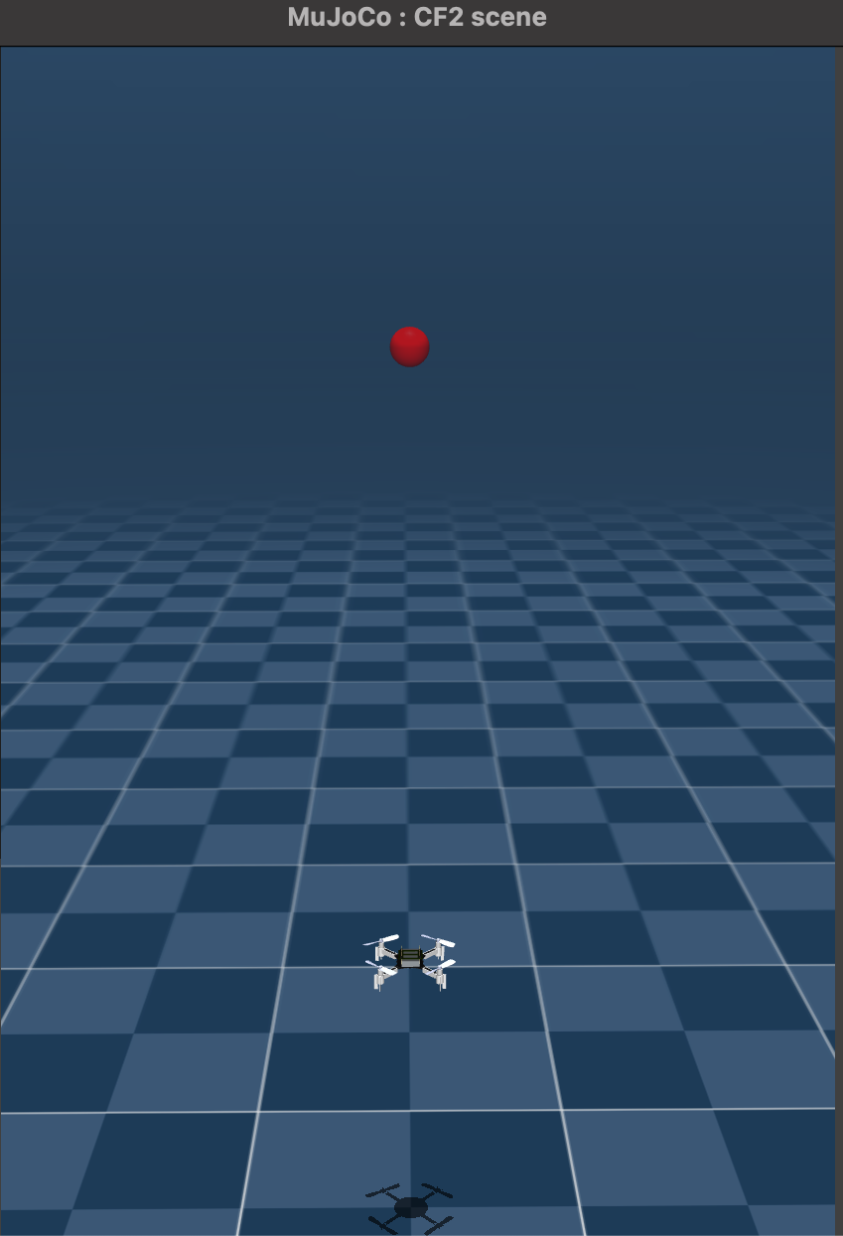
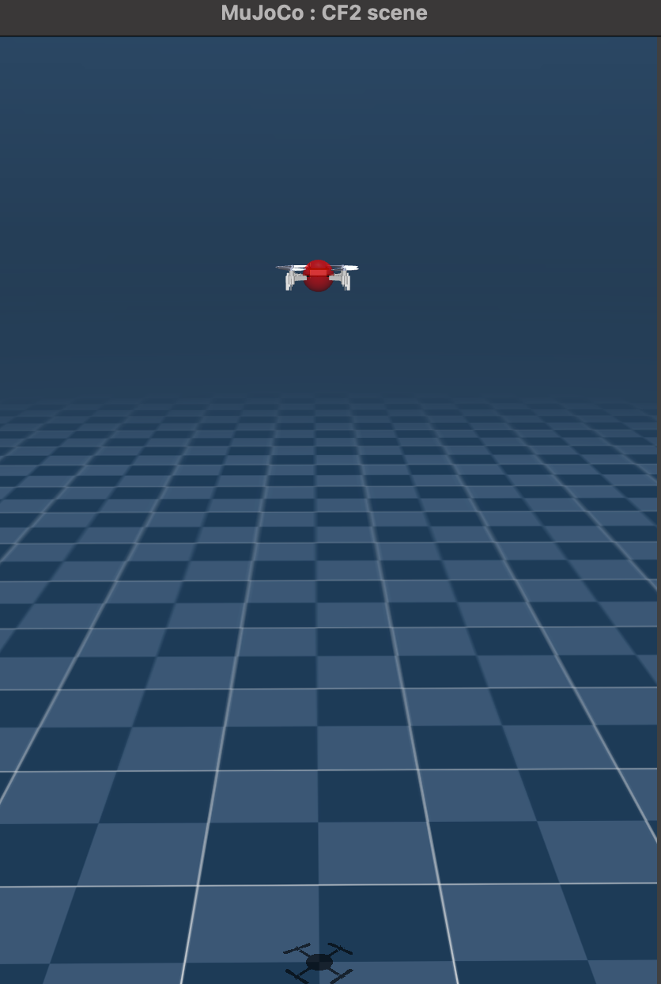
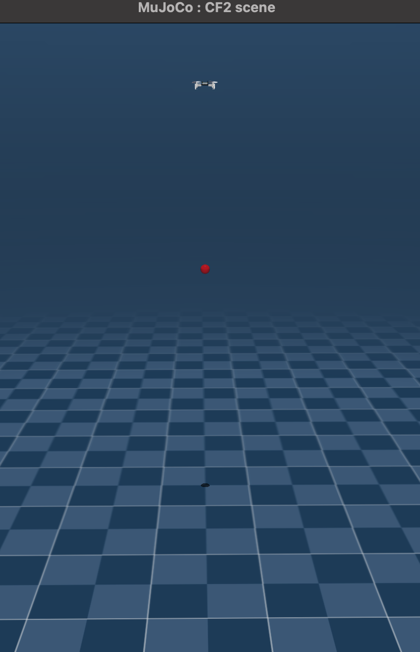
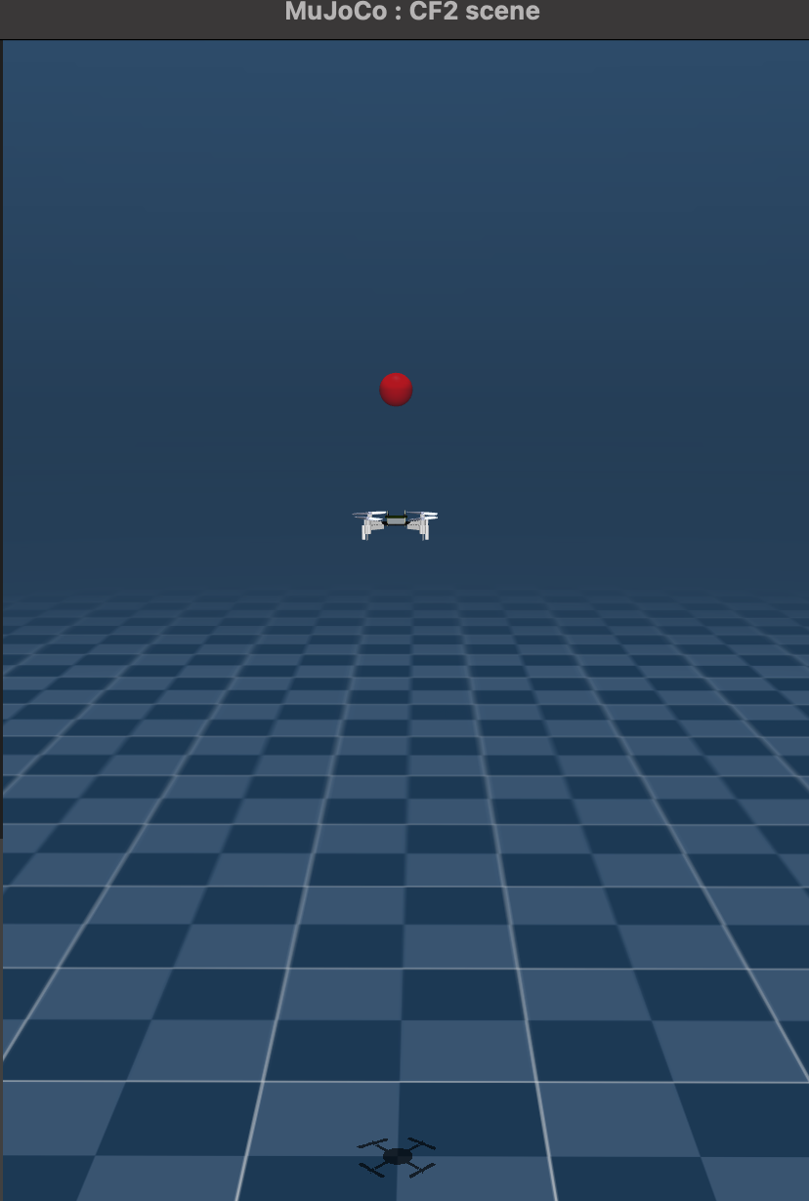
T = 1
T = 2
T = 3
T = 4
Current Goal: Hovering towards a target at [0, 0, 1] (thrust only)
Result: Oscillation about target (or gets stuck on ground / flies high)

Slide 6
Plan for the Next Two Weeks
Goals
  Learn a single drone to hover at a target in any [X, Y, Z]
    Perhaps hover at target T, then return to starting position and land
  Learn about MAPPO theory and implementation
Dependencies
  Researching / testing the parameters and current setup
    Need consistent behaviour convergence
    Need reduced oscillation

Slide 7
Roadmap Checkpoint
Week 2: Imperfect single agent hovering at target on Z axis
Week 4: Next milestone
Final deadline: Deliverables (e.g., report, demo, paper draft)
Note shifts in schedule here so I can track drift

Slide 8
Discussion Points / Questions
General feedback on the current setup (Main issue: Target Oscillation)
  Environment → Pure RL control (e.g. no thrust baseline)
    During training, drone initialized to random position on Z-axis [0, 0, Z]
    Reward based on distance improvement (reward += old distance - new distance)
    Episode termination based on N ~100 number of steps
  PPO-Clip
    Update policy every n ~1k steps, over N ~100k total timesteps
    Anneal learning rate linearly (fine-tune the policy, encourage exploration at start)
    Minibatches, KL-Divergence check, and Entropy bonus
  Plan
    Experiment with minor changes to the environment and/or policy
      I am working on a script to test different values across PPO / env parameters

Slide 9
Log Snapshot (Cumulative)
Date | Progress Summary | Next Steps | Notes
Sept. 16 | Set up MuJoCo sim; baseline PPO-Clip training | Refine current setup, explore MAPPO theory | Policy / env is current imperfect / inconsistent
Sept. 30

Slide 10
Week 2
Single-Agent Hover

Slide 11
MIRL LAB Honours Project Bi-Weekly Update
MARL Crazyflie
Michael O’Sullivan, Aydin Yalcinkaya
Using MARL to learn safe take-off and hover policies for Crazyflie drones
CrazyFlie, MuJuCo, Gymnasium, PyTorch

Slide 12
Progress Recap
Goal: Implementing MARL on Crazyflie drones for safe hovering and navigation
Progress
Base environment for training a single drone to hover at a target
Vectorized single agent PPO-Clip that interacts with the environment
  Runs 1 or more environments in parallel for better sampling
Engineered features to help the agent understand observation relationships

Slide 13
Progress Since Last Meeting
Vectorized environments: Agent can run multiple envs in parallel
  Using SB3 VecEnv → Agent uses batched observations and actions
Hyperparameters and training schedule: Adjusted based on testing
  E.g. now running ~1500 step episodes for 150 000 total steps
Feature engineering: Modifying base (pos/vel/rot) features to help the agent establish meaningful connections: ~100 features in obs space
  E.g. relative position to target, (squared) distance to target, some are more complex, e.g. direction to target in the drones local coordinate system (body→world rotation matrix @ direction vector)
  Tracking observation gradients during eval run to guide engineering
Results: Better sampling, less variant and more successful behaviour

Slide 14
Plan for the Next Two Weeks
Goals
  Learn a single drone to hover at a target in any [X, Y, Z]
    Perhaps hover at target T, then return to starting position and land
  Learn about MAPPO theory and implementation
Dependencies
  Currently, feature engineering has yielded the most improvement
    Experiment with other features, possibly adjust hyperparameters and training

Slide 15
Roadmap Checkpoint
Week 2: Imperfect single agent hovering at target on Z axis
Week 4: Successful [0, 0, Z] hover, imperfect [0, Y, Z] hover
Week 6: Next milestone
Final deadline: Deliverables (e.g., report, demo, paper draft)
  Early December
Shifts in schedule
  Had planned to get [X, Y, Z] hovering working this week, so slightly behind (although this was an ambitious goal)

Slide 16
Discussion Points / Questions
Feature engineering discussion
  As I understand it, feature engineering will speed up the learning process and reduce training time
  Comparable projects (Champion-level drone racing using deep reinforcement learning) use a more basic observation space
    Pos/Vel & Rotation matrix (15) + Relative pos of next quadrant (12) + prev action (4) → Total 31
    More rigorous training: 100 parallel envs, 100 million steps
    Us: 24 envs, 3.6 million steps (24 envs, 150000 steps per)
  Is our approach (~100 features) reasonable?
    Implications for running on actual drones (e.g. feature noise)?

Slide 17
Log Snapshot (Cumulative)
Date | Progress Summary | Next Steps | Notes
Sept. 16 | Set up MuJoCo sim; baseline PPO-Clip training | Refine current setup, explore MAPPO theory | Policy / env is current imperfect / inconsistent
Sept. 30 | Successful Z hover. Semi-successful YZ hover | Refind YZ hover and move to XYZ, explore MAPPO theory

